Slide 1
Security Analysis & Mitigtions on UVIC Spam Detector
Group 11 MTIS

Slide 2
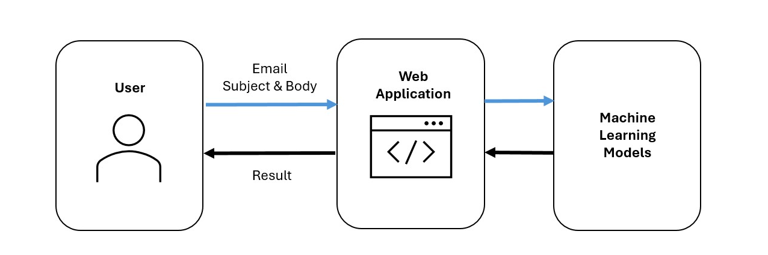
System Architecture
Stateless
Lightweight
No data retention
Practical

Slide 3
Security Analysis
Website
Man‑in‑the‑Middle (MITM)
Passive (profiling Build databases of intercepted emails for later exploitation)
Active (Modify the response payload on the fly to manipulate classification results)
Denial of Service (DoS/DDoS)
Machine Learning
Evasion
Feedback (Logistic Regression)
Model Extraction (All models)

Slide 4
Mitigations
Rate Limiting & Monitoring
Dos/DDos and Model Extraction
Output Minimization
Evasion using feedback
AWS Service
MITM and Dos/DDos

Slide 5
Future Extensions & Challenges
Intrusion Detection Systems (IDS)
Firewalls
Email system APIs
Browser extensions
High accuracy
Low latency
Scalability
Notes:
This system could be extended into various platforms, including integration into IDS and firewall pipelines for early detection, deployment as a backend API for email clients, or packaged as a browser extension to assist end users directly in web-based email environments. low-latency performance under high email volume, securing API access against misuse, and maintaining model accuracy across varied input formats. deployment in security-critical systems requires high reliability and strict data handling guarantees
maintain fast, reliable performance under high traffic

